Slide 1

Media-Induced Fear and Impact on Travel Choices
An Unrecognized Opportunity for Growth?

Slide 2
Contents
Media frenzy and passenger anxiety
The truth about domestic travel safety
Historical times-of-crisis data
Industry projections
How to benefit long-term from COVID pandemic

Slide 3
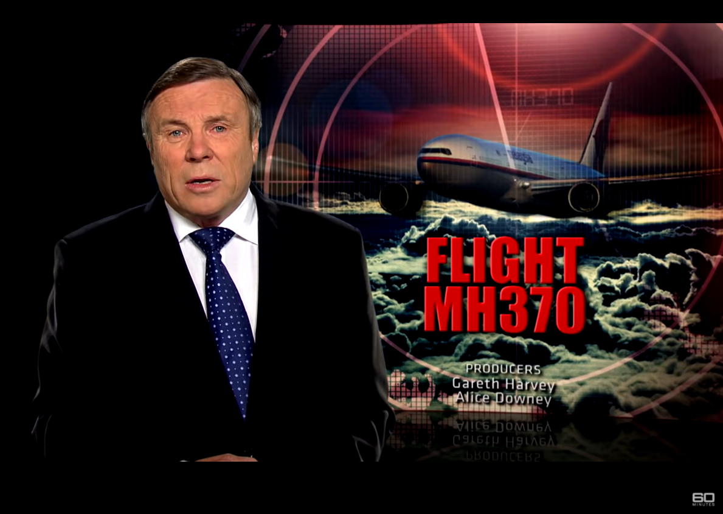
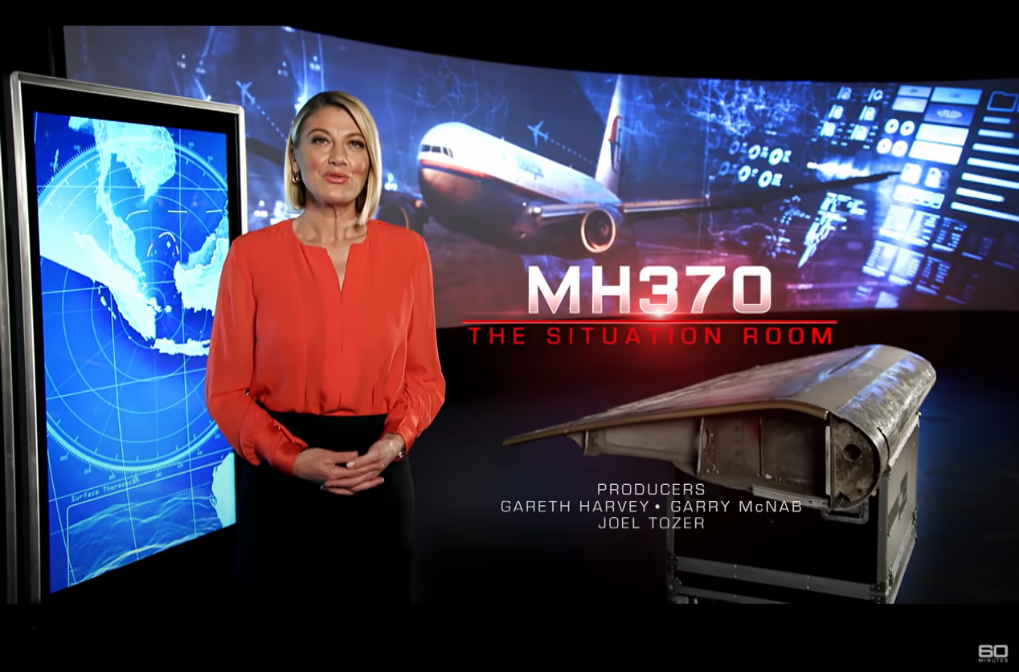
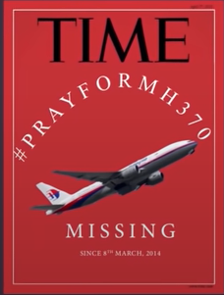
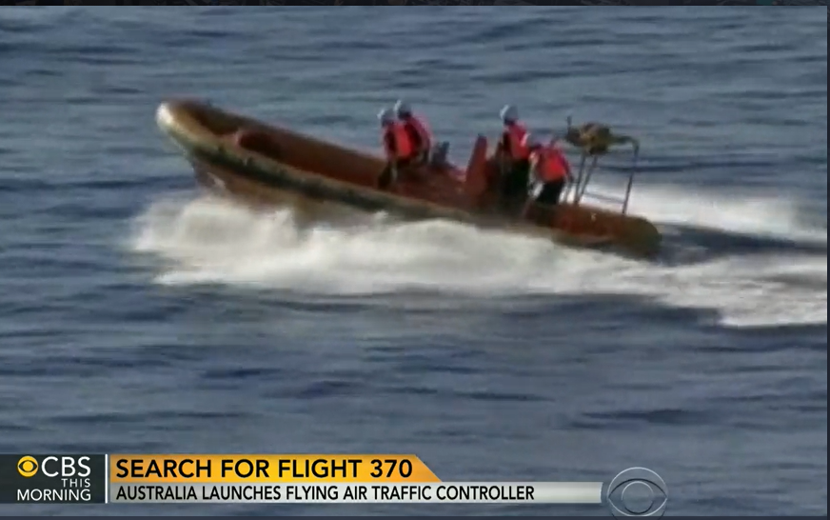
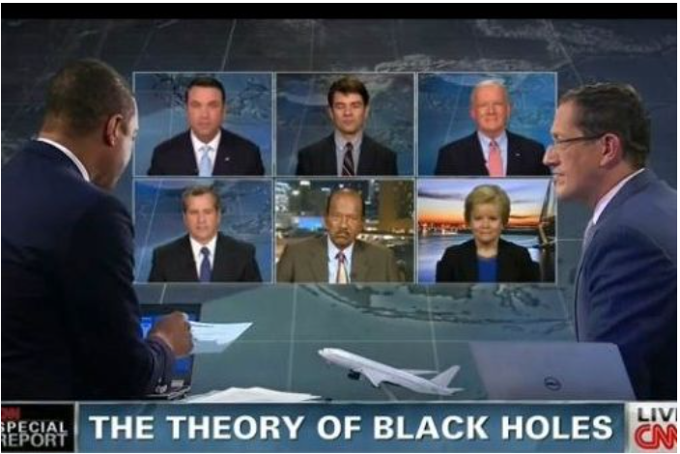
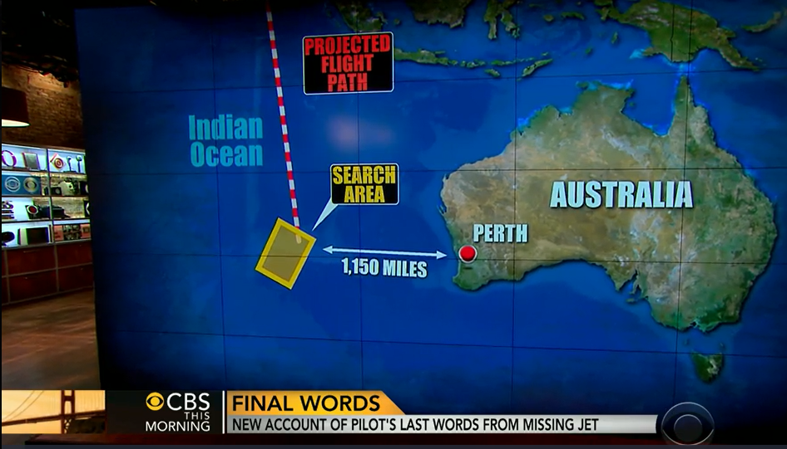
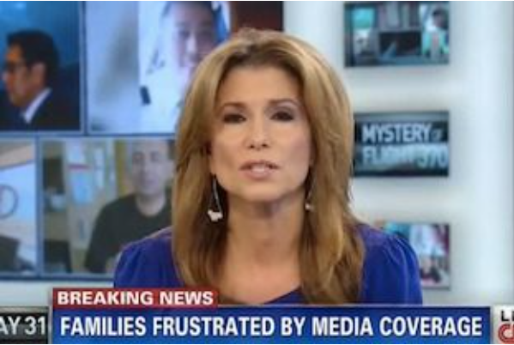
Constant coverage…
Notes:
Failure to locate the missing jet created a weeks’ long media frenzy, with speculation even including the possibility that the flight had disappeared into a black hole.
It was ultimately determined to be a premediated suicide, with the entire flight as collateral damage.
Sources: CNN, CBS. 60 Minutes, TIME

Slide 4
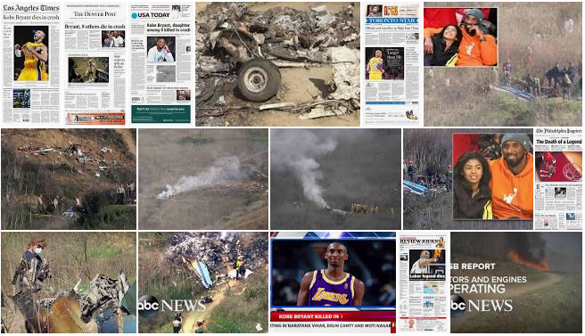
…of aviation tragedies by the media…
Notes:
While the death of basketball celebrity Kobe Bryant occurred in a helicopter, newspaper headlines and accident scenes all over television news did not specify that up front. It is likely that in many viewers memories, this accident is filed under ‘airplane crashes of celebrities.’
Sources: ABC News, various newspaper headlines

Slide 5
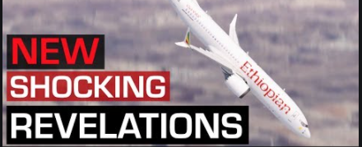
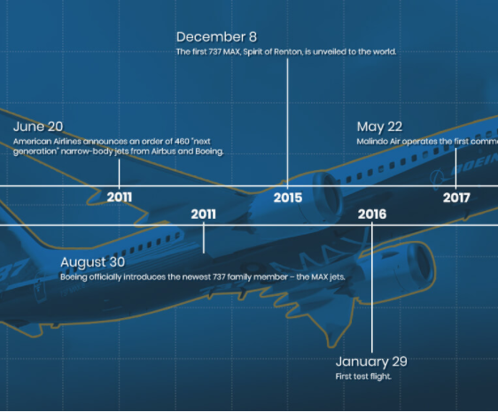
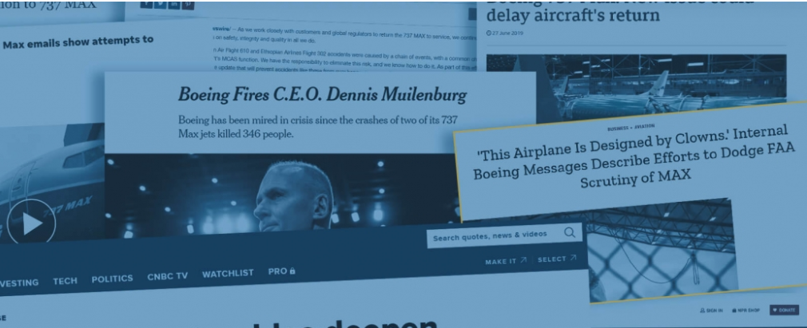
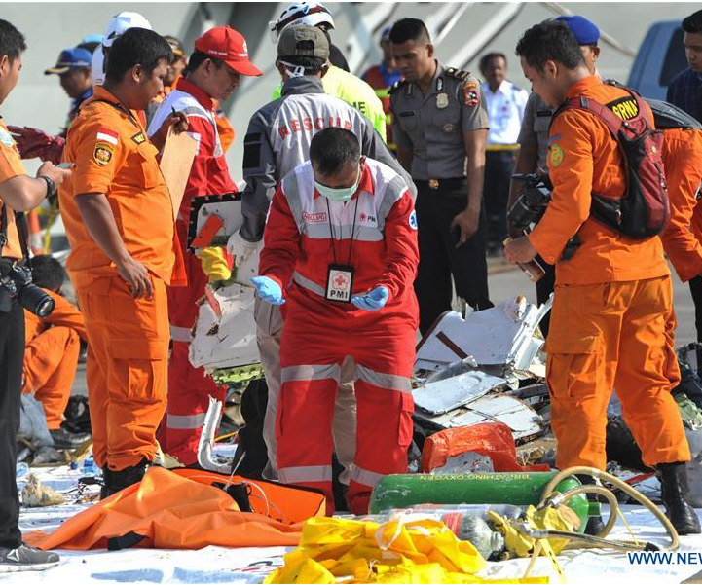
…leaves 33-40% with some form of flying-related anxiety.
Notes:
Statistic from stratosjets.com
International Boeing 737 Max crashes that led to grounding of the entire fleet
These images are enough to cause anxiety in people who’ve never had it before!
Sources: https://www.aerotime.aero/23728-boeing-737-max-crisis
https://www.aerotime.aero/26438-faa-un-grounds-the-boeing-737-max
60 Minutes
http://www.xinhuanet.com/english/2018-10/29/c_137566980.htm

Slide 6
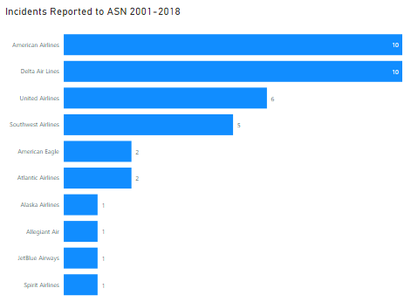
But when we look at the FACTS…
…we find very few reported incidents
involving major domestic carriers.
Notes:
Source: https://aviation-safety.net/database/

Slide 7
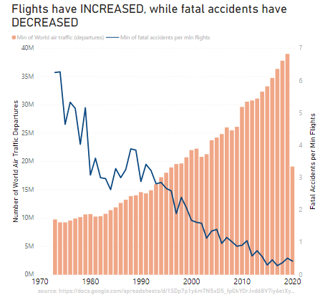
Even globally,
Notes:
Source: https://docs.google.com/spreadsheets/d/1SDp7p1y6m7N5xD5_fpOkYOrJvd68V7iy6etXy2cetb8/edit#gid=1448957446

Slide 8
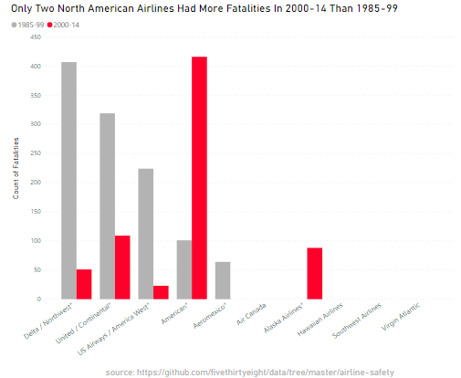
Deaths are down in North America.
265 of the ‘red’ era deaths occurred on September 11, 2001.
Notes:
As we all know, 9/11 flights account for all of the ‘red’ fatalities for United (109) and many of them for American (156).
Twin Towers crashes:
American Airlines Flight 11: 92 lives lost
United Airlines Flight 175: 65 lives lost
Pentagon:
American Airlines Flight 77: 64 lives lost
Field near Shanksville:
United Airlines Flight 93: 44 lives lost
Source: September 11 attacks - Wikipedia

Slide 9
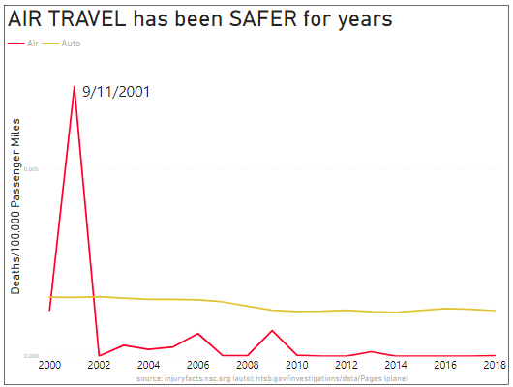
Other than 2001 with the attacks of 9/11,
Notes:
Auto data is from https://injuryfacts.nsc.org/motor-vehicle/overview/introduction/
Aviation data is from https://www.ntsb.gov/investigations/data/Pages/Data_Stats.aspx

Slide 10
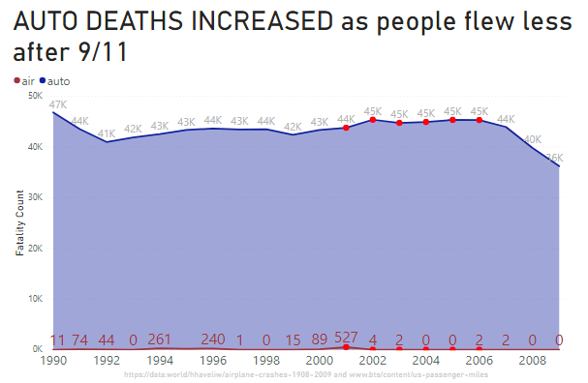
In fact,
Notes:
Look at the red values.

Slide 11
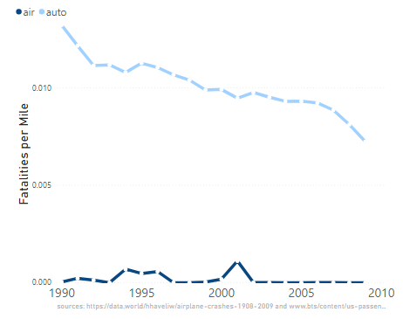
U.S. automobile safety may NEVER catch up with airline safety!
Notes:
The title of the slide is the yellow comment.

Slide 12
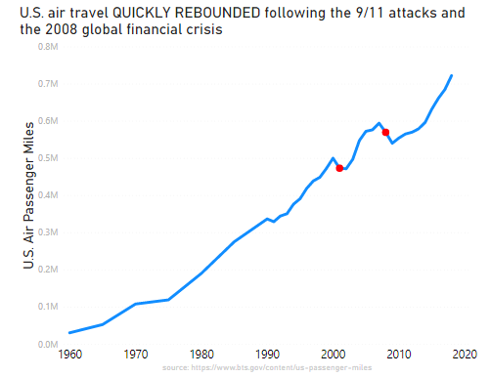
We’ve learned from recent years that when air travel plummeted;
It quickly rebounded.

Slide 13
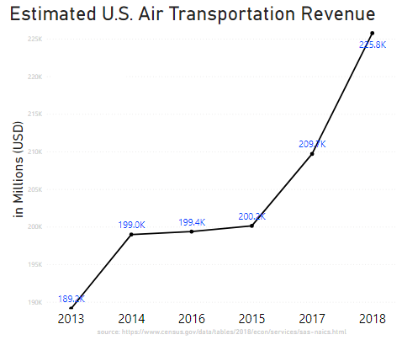
And industry growth projections (COVID not-withstanding) are excellent;

Slide 14
Given the safety FACTS and industry PROJECTIONS,
and given that a record number of people are not flying “due to COVID,”
and understanding that fear of flying is NOT CORRELATED with increased risk, but with EMOTION,
we are faced with an UNPRECEDENTED OPPORTUNITY to INCREASE OUR MARKET SHARE.
Notes:
If passengers are hearing ‘anti-airline’ safety messages in the media, we can use that to our marketing advantage. Don’t let a crisis go to waste!
People are afraid of COVID, but still need to fly. If we can redirect their anxieties to how we handle COVID (by branding ourselves as ‘ultra-sanitary’ and caring both about our passengers and our team), we can win them from the competition and be in a better position when those passengers resume their regular flying frequencies and continue to choose us.

Slide 15
Marketing Blitz: “We care about YOU!”
Don’t let a crisis go to waste. Remember, emotion rules!
Opportunity to pull business travelers from other carriers
Focus on COVID safety measures
Brag about HEPA filtration
Mandate crew vaccinations
Test all ground and flight crew weekly
Unlimited leave for symptomatic staff
Explain enhanced cleaning techniques
BLOCK MIDDLE SEATS and do NOT charge more
Permanently pull ‘one-airline’ travelers from our competitors
Notes:
Pulling unique travelers permanently is ASTONISHINGLY HARD to accomplish during normal times.
We need to advertise these things so anxious business travelers on the fence about flying will choose OUR airline during COVID times. Some of them are going to remain with us once COVID is over. That is nearly impossible to do otherwise.
Regarding the blocked middle seats and expense incurred; Think about it like this – Today we might be paying for someone to have the luxury of not having a person adjacent while in flight, but that same person probably normally flies MANY times a year and is likely to STAY WITH US and resume flying WITH US several times per year – after COVID.

Slide 16
Media-Induced Fear and Impact on Travel Choices
Do Not Let This Opportunity Go To Waste

Slide 17
References
Deane, S. (2020, September 29). Fear of Flying Statistics (2020 Data). Stratos Jet Charters, Inc. https://www.stratosjets.com/blog/fear-of-flying-statistics-trends-facts/
Pombal, R. (2020, November 3). Risk of COVID-19 From Flying. JAMA. https://jamanetwork.com/journals/jama/fullarticle/2771435
Wikimedia Foundation. (2021, January 13). September 11 attacks. Wikipedia. https://en.wikipedia.org/wiki/September_11_attacks
Notes:
Chart sources are listed on bottom of chart or in PowerPoint notes of the corresponding slide.

Slide 18
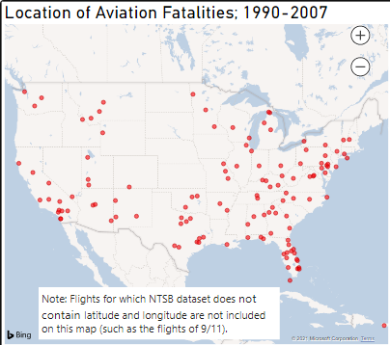
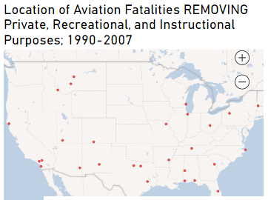
Notes:
Supplemental chart

